Slide 1


VERON R&D Technology – Semiconductor Solutions

Slide 2
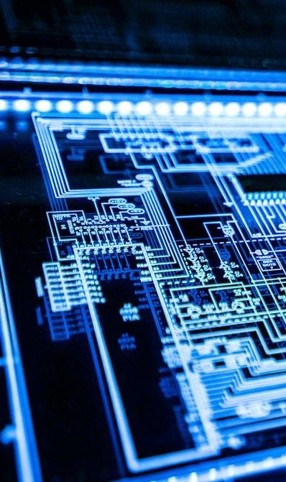
Profile
R&D Group was established in 2024.
Provides full turn-key hardware solutions for semiconductor ICs, including Analog and Digital Circuits Design.
Specializes in High Speed PHY Design, RTL Design, Mixed-signal and low power circuit design.
PCB FABRICATION
PCB/PROBEHEAD ASSEMBLY

Slide 3
Mission Statement
R&D Group is steadfastly dedicated to excellence, quality, and cost-efficiency, and pursues the consistent delivery of these values to every client.

Slide 4
Core Values
Cost Efficiency and Global Competitiveness: Our organisation sustains a competitive advantage by leveraging a highly cost-efficient labour force, enabling operational expenditures that are consistently below prevailing domestic and international benchmarks.
Resilience and Discipline: Our design team thrives in high-pressure contexts, exhibiting exemplary professional discipline and an unwavering dedication to the delivery of superior outcomes.
Innovation and Development: We cultivate a state-of-the-art research and development milieu that empowers engineers to advance their expertise, generate novel solutions, and extend the frontiers of contemporary technology.
Collaboration and Customer Focus: We nurture a deeply collaborative culture in which every team member contributes seamlessly to client support, thereby ensuring the successful execution of all project objectives.

Slide 5



Services & Capabilities
Advanced IC Design Services for Diverse Applications
Specialize in Hand-on
Solutions
R&D Group specializes in hands-on IC design services, partnering closely with clients from initial ASIC architecture and front-end RTL development through analog/mixed-signal block creation, rapid FPGA prototyping, deliver practical, production-ready solutions.
R&D Group offers a comprehensive portfolio of integrated-circuit (IC) design services encompassing ASIC, front-end RTL development and verification, analog/mixed-signal block design, FPGA prototyping, physical implementation (floor-planning, place-and-route, timing closure).
Expertise in High-Speed PHY
Design and Verification
R&D group focus on architect high-speed optical PHYs by selecting optimal IP cores, designing robust analog front-ends with rigorous signal-integrity assurance, and implementing adaptive digital calibration and DSP algorithms.
Engineering Expertise in Design and verification
Our team of skilled engineers integrates design and verification expertise, driving innovation and effective solutions in the hardware design implementation.

Slide 6

Utilizing Advanced Tools for IC Design and Simulation
1
2
3
4
Expertise in Synopsys and Cadence for IC Design and Simulation
Advanced ICs Design Techniques for High-Speed Applications
Simulation Capabilities to Ensure Optimal Performance
Comprehensive Design Support from Concept to Production
We employ cutting-edge design techniques to develop integrated circuit that meet the demands of high-speed digital, analog and mixed-signal applications.
Our team uses advanced simulation tools to analyze signal integrity (SI), power integrity (PI), and power distribution networks (PDN) for improved high speed performance.
From initial design concepts to final production, our team provides extensive support to ensure the performance of projects meet industry standards and deliver superior functionality.
Our talented engineers leverage Synopsys and Cadence tools to create precise IC layouts and simulations, ensuring high quality and efficiency in the design process.

Slide 7
Technical Capabilities in IC Design
1
2
3
4
Expertise in HDI Processing
Comprehensive IC Design Services
We deliver comprehensive, hands-on IC design services—spanning front-end RTL development, analog/mixed-signal & RF block design, digital synthesis and timing-closure, through full-chip physical implementation—for high-performance applications.
Advanced Simulation Tools
Materials and Specifications
Our HDI processing capabilities ensure that we meet the demands for high- density interconnections, essential for modern electronic devices and circuits.
Utilizing advanced tools like SYNOPSYS and CADENCE for IC simulation, ANSYS for SI and PDN with high accuracy, we deliver precise pre and post-layout design services.
We select architecture and topology designed for high-speed applications, ensuring minimal noise and optimal signal integrity across all IP PHY design.

Slide 8
Offering Extensive IC Design Architecture
*
Specialization in IP PHY design
We specialize in the architecture featuring up to multiple analog and digital blocks, enabling complex designs that meet the latest technological demands.
*
High Security for Optical Transport Network
Our OTN IP delivers full ITU-T G.709 compliance, integrated high-performance error correction, dynamic grooming, and silicon-proven reliability for rapid, low-power deployment in carrier networks.

Slide 9
General Process
Specification Definition
Design Architecture
Circuit Design/ RTL Design
Packaging and Integration Concerns
Post-Layout Verification
Layout Design
General Process
Documentation and Deliverables
Silicon Validation Requirements

Slide 10
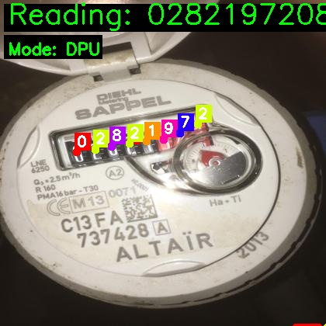
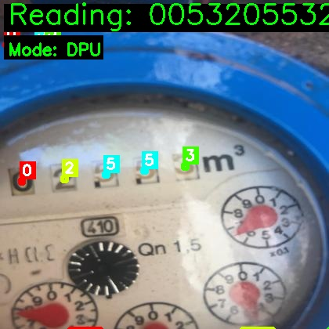
Products Delivered: DPU-Smart water box

Slide 11
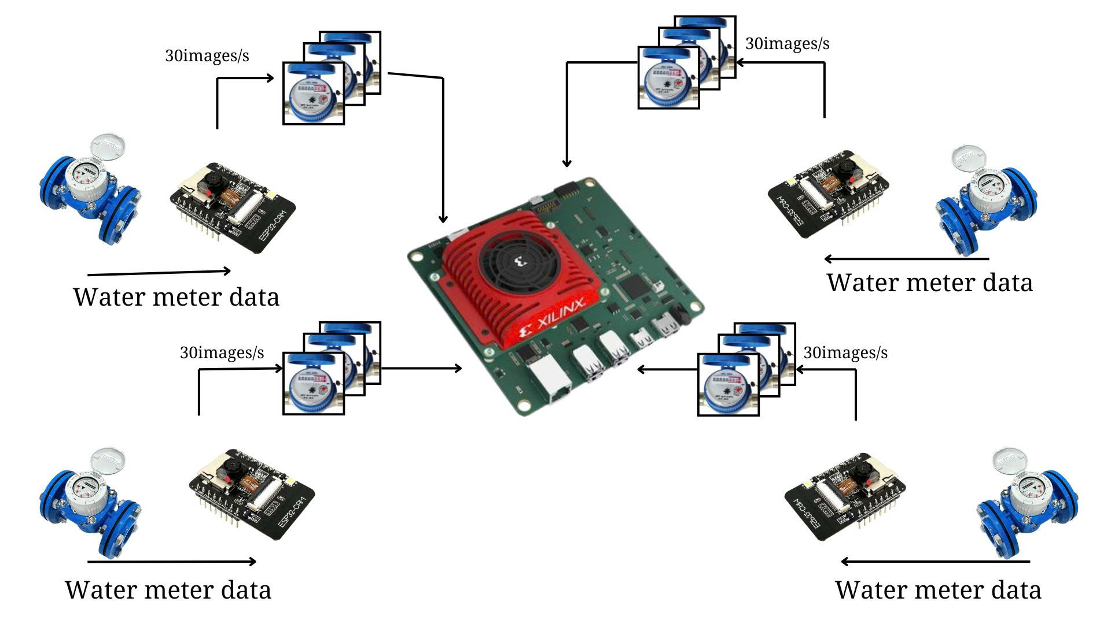

Slide 12
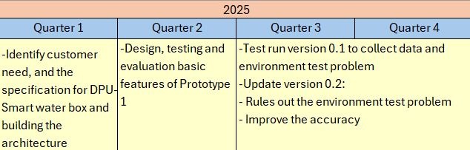
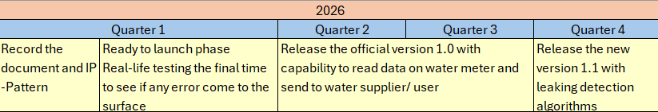
PRODUCT PLAN

Slide 13

Products Delivered: DPU-Smart Traffic box

Slide 14


Products Delivered: DPU-Smart Traffic box

Slide 15
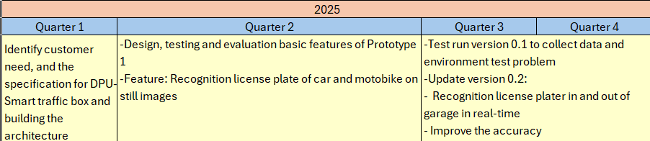
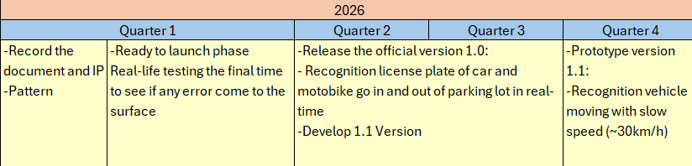
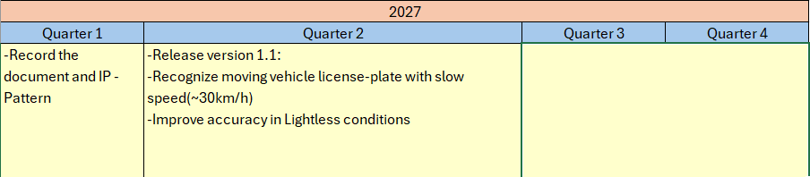
PRODUCT PLAN

Slide 16
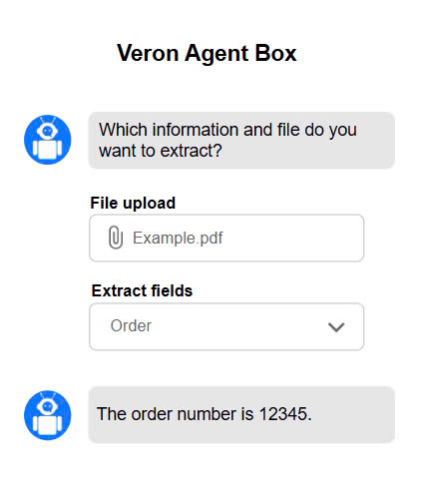
Products Delivered : DPU-AI agent box

Slide 17

Products Delivered : DPU-AI Robotic Arm System

Slide 18
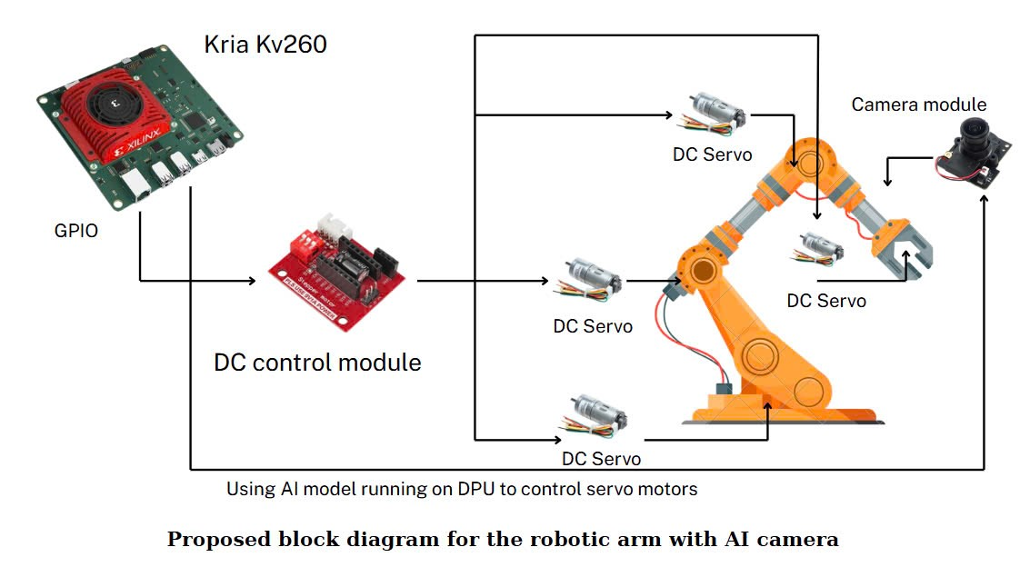

Slide 19
Delivery IP:
PCIe gen 5
Ethernet 10GB - 100GB
Doubles per-lane bandwidth to 32 GT/s and relies on tightly pipelined PCS/PMA/Transaction layers with FEC and elastic buffering to meet high transmission speed timing and interoperability.
Spans 10 Gbps to 100 Gbps using 64b/66b or PAM4 over multi-lane SerDes, integrating MAC, PCS, PMA, FEC, elastic FIFOs, and auto-negotiation FSMs for robust, standards-compliant links.
Optical transport network
Implements ITU-T G.709 framing with OPU/ODU mapping, pointer-based alignment, Real-time FEC, and OAM overhead in RTL design, ensuring hitless switching, deterministic latency, and carrier-grade resilience.

Slide 20
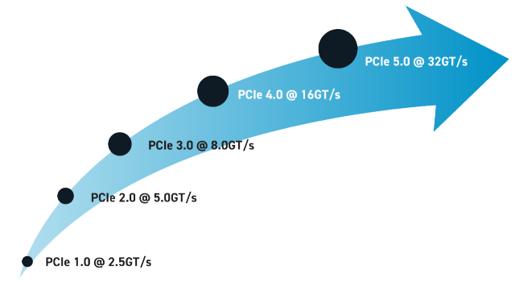
Products Delivered : PCIe gen 5

Slide 21
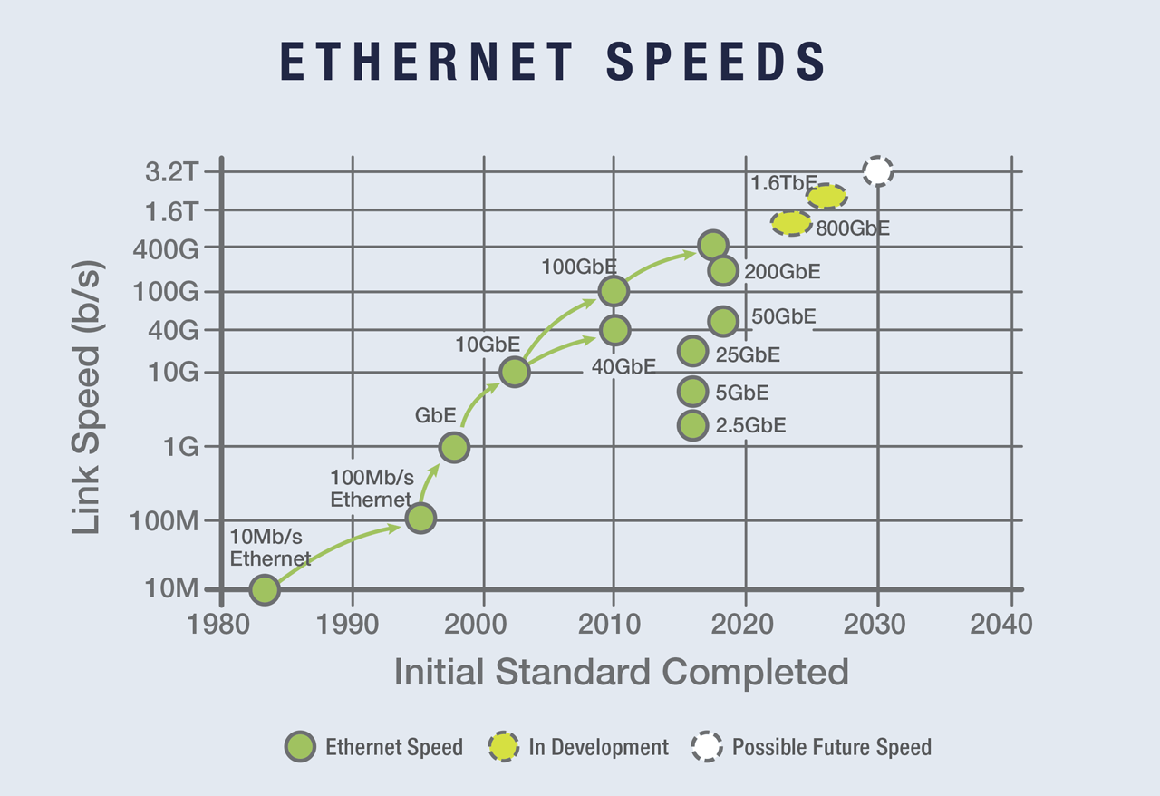
Products Delivered:Ethernet 10GB – 100GB

Slide 22
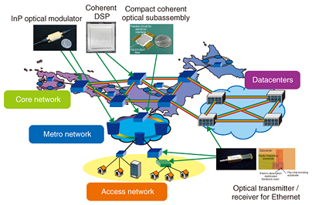
Products Delivered : Optical Transport network IP

Slide 23
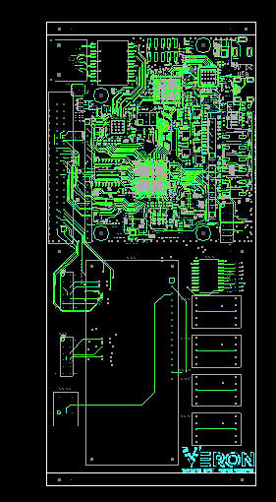
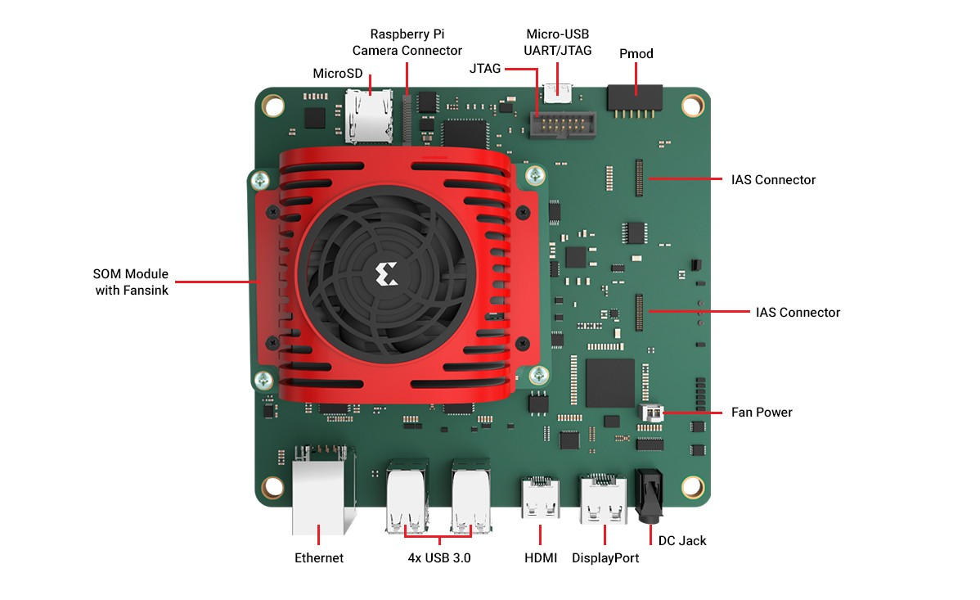
Equipment

Slide 24
















Support Industry Leaders Driving Cutting Edge Semiconductor Design Solutions

Slide 25

Thank You

